Slide 1



DEPARTMENT OF ELECTRONICS AND COMMUNICATION ENGINEERING
18ECP105L-MINOR PROJECT- III
PROJECT REVIEW
IoT BASED FIRE DETECTING AND NOTIFICATION SYSTEM
PRESENTED BY:
ANBARASI S (927622BEC009)
ARCHANA V (927622BEC015)
DHARSHINI K (927622BEC038)
DIVYAASRI S (927622BEC044)
GUIDED BY,
Dr.M.DHARANI DEVI, AP/ECE
BATCH NUMBER: 10
DATE: 02.12.2024

Slide 2
OBJECTIVE
To Develop an IoT-based system designed to detect fire hazards in real-time using various environmental sensors.
To provide remote monitoring, reduce false alarms, and ensure quick emergency response to prevent loss of life and property.
To Implement sensors to continuously measure temperature, smoke presence to detect potential fire hazards.

Slide 3
ABSTRACT
The aim of this project is to improve fire safety management in a variety of settings.
To precisely identify fires, the suggested system makes use of a network of sensors, including gas, temperature, smoke, and flame sensors.
A microcontroller unit processes the sensor data, triggering a reaction system that activates a water pump to suppress fires and notifies emergency responders and stakeholders via automated voice calls and SMS.

Slide 4
INTRODUCTION
Fire safety is a critical concern in a wide range of environments, including residential buildings, industrial facilities, and high-risk areas such as warehouses, laboratories, and power plants
This project proposes an innovative fire safety management system designed to address these challenges, automated suppression mechanisms, and real-time communication capabilities.

Slide 5
LITERATURE SURVEY
Paper Title | Authors | Methodology | Sensors Used | Communication Protocol | Result
IoT-Based Fire Detection and Monitoring System | A. Kumar, S. Sharma (2020) | This system detects fire using temperature and smoke sensors and alerts users via an Android application | Temperature, Smoke Sensor | Wi-Fi, MQTT | Real-time monitoring with high accuracy of fire detection
IoT-Based Fire Detection and Control using Raspberry Pi | K. Reddy, V. Gupta (2021) | Fire detection using Raspberry Pi and different sensors for real-time monitoring and automatic sprinkler activation | Temperature, Gas Sensor | MQTT, Wi-Fi | Immediate control action and real-time alerts using MQTT protocol

Slide 6
EXISTING METHOD
Fire Detection and Alarm System using IoT:
Method: Smoke sensors can use ionization or photoelectric methods to detect particles in the air, while flame sensors detect light wavelengths associated with fire.
Control Mechanism: When smoke or flame is detected, the system triggers alarms, and connected devices (like sprinklers) can be activated.

Slide 7
PROPOSED METHOD
To create a unique IoT-based automatic fire detection and notification system, the choice of components is essential to ensure reliability, scalability, and efficiency.
It may also activate automatic safety protocols, like sprinkler systems or shutting off electrical power to reduce fire spread

Slide 8
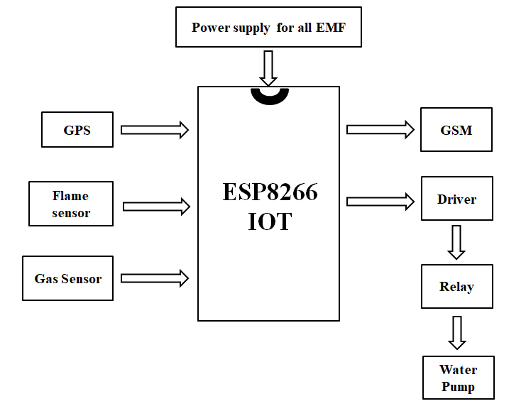
BLOCK DIAGRAM

Slide 9
COMPONENTS
ESP8266 IOT
Flame Sensor
Gas Sensor
GPS
GSM module
Relay

Slide 10
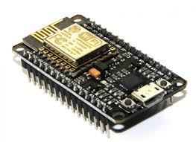
ESP8266 IOT
The ESP8266 is a widely used microcontroller for IoT applications due to its low cost, compact size, and built-in Wi-Fi capabilities.
The ESP8266 is particularly popular in home automation, environmental monitoring, and real-time alert systems such as fire detection.

Slide 11
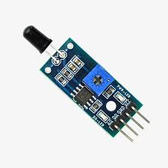
FLAME SENSOR
A flame-sensor is one kind of detector which is mainly designed for detecting as well as responding to the occurrence of a fire or flame.
The flame detection response can depend on its fitting.

Slide 12
GPS
First of all, emergency personnel can swiftly respond to the event thanks to GPS coordinates, which make it easier to identify fire sites.
Second, by tracking GPS locations continuously, the device can follow the spread of the fire, allowing authorities to take proactive steps to contain it.

Slide 13
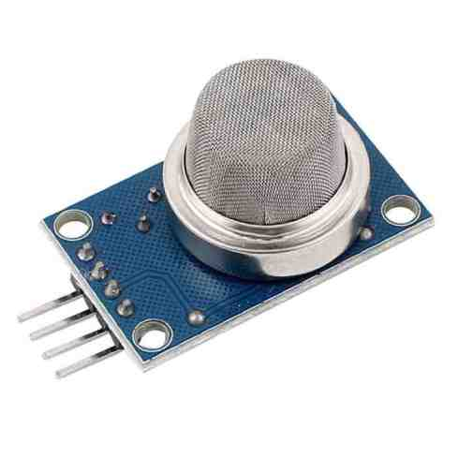
GAS SENSOR
An electrical resistance change occurs in the sensor when a gas molecule makes contact with its surface.
This shift corresponds to the gas's concentration. The IoT platform receives the sensor data after it has been read by the microcontroller.

Slide 14
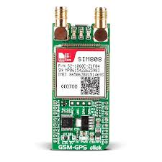
GSM
A GSM module or a GPRS module is a chip or circuit that will be used to establish communication between a mobile device or a computing machine and a GSM or GPRS system.
The modem (modulator-demodulator) is a critical part here.

Slide 15
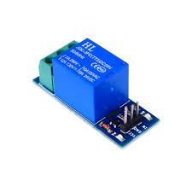
RELAY
This part serves as a switch to regulate when external equipment, like emergency lighting and sprinkler systems, are turned on.
The electromagnetic induction theory underlies the relay's operation. The relay contacts change states when the relay coil is activated in response to a signal from the microcontroller.

Slide 16
CONCLUSION
The system successfully detects fire incidents in real-time using sensors such as temperature sensors, or flame sensors.
The system sends notifications via various channels such as SMS, mobile app alerts, or emails when a fire is detected .
It may also activate automatic safety protocols, like sprinkler systems to reduce fire spread. Low Power Consumption.

Slide 17
REFERENCES
[1] Sarwar, Barera et al. “An Intelligent Fire Warning Application Using IoT and an Adaptive Neuro-Fuzzy Inference System.” Sensors (Basel, Switzerland) vol. 19,14 3150. 17 Jul. 2019, doi:10.3390/s19143150
[2] Saeed F., Paul A., Rehman A., Hong W.H., Seo H. IoT Based Intelligent Modeling of Smart Home Environment for Fire prevention andSafety.JSens.ActuatorNetwork.2018;7:11.doi:10.3390/jsan701001
[3] Manolakos E., Logaras E., Paschos F. Wireless Sensor Network Application or Fire Hazard Detection and Monitoring. Lecture Notesof the Institute for Computer Sciences. Soc. Inform. Telecomm.Eng. 2012;29:1– 15.
[4] Soliman H., Sudan K., Mishra A. A Smart Forest Fire Early Detection Sensory System, Another Approach of Utilizing Wireless Sensor and Neural Networks; Proceedings of the IEEE SENSORS 2010 Conference; Kona, HI, USA. 1–4 November2010
[5] Sowah R., Ampadu K.O., Ofoli A., Koumadi K., Mills G.A., Nortey J. Design and Implementation of a Fire Detection and Control System for Automobiles using Fuzzy logic; Proceedings of the IEEE Industry Applications Society Annual Meeting; Portland, OR, USA. 2–6 October 2016.

Slide 18


